Slide 1


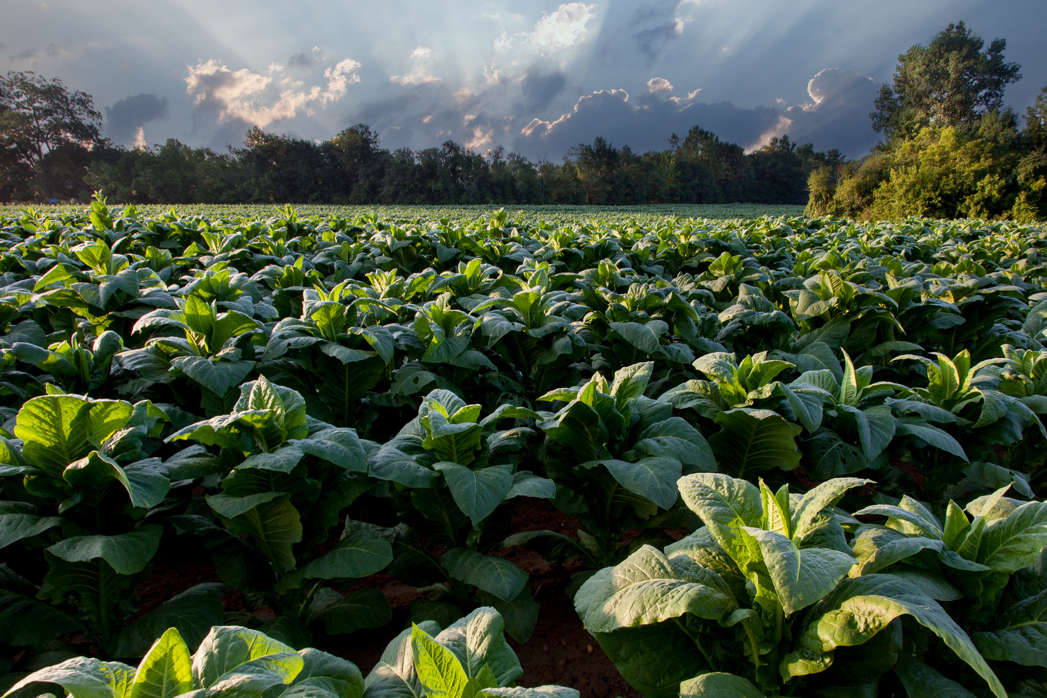


AGRIFARM COMPANY
ANALYSIS PRESENTATION

Slide 2



Page 01
Introduction
Resource
:
KAGGLE
Dataset
:
Agricultural Products Sales
Time series
:
2022-2023
About Dataset
:
This dataset provides comprehensive information on agricultural product sales, supply chain metrics, and pricing across various categories, including Vegetables, Fruits, Grains, Dairy, and Livestock, for the years 2022 and 2023.

Slide 3

Page 02
Let’s Meet Our Team!
1
2
Hajar abdulhamed Mohamed
Jana Sherif Sharaka
4
3
Rawan Mohamed Eltayeb
Mahmoud Ahmed Mahmoud

Slide 4

Page 03
Project Analysis Goals
Revenue Analysis
Supplier Performance
Product Demand Analysis
Analyze the total revenue generated from different categories such as Dairy, Grains, Livestock, Fruits, and Vegetables, and identify the highest-performing products within each category.
Determine which specific products (e.g., milk, wheat, tomatoes) generate the most sales and revenue to optimize supply chain and inventory decisions.
Measure the contribution of different suppliers in terms of total units sold (kg) and revenue generated to evaluate supplier efficiency.

Slide 5
Page 04
Project Analysis Goals
Understanding Cost Distribution
Monthly Trends
Service Provider Performance
Analyze the total maintenance fees and average fees per tool to identify which tool incur the highest maintenance costs.
Investigate monthly variations in maintenance fees and product counts to inform strategic planning and resource management.
Evaluate the effectiveness of different service providers based on the maintenance fees charged and the quality of service delivered.

Slide 6
Page 05
Analysis Steps
1
2
Get Dataset From Kaggle Website
Open Data From the Source ( Excel )
4
3
Load Data Into Power BI
Transform Data in Power Query

Slide 7

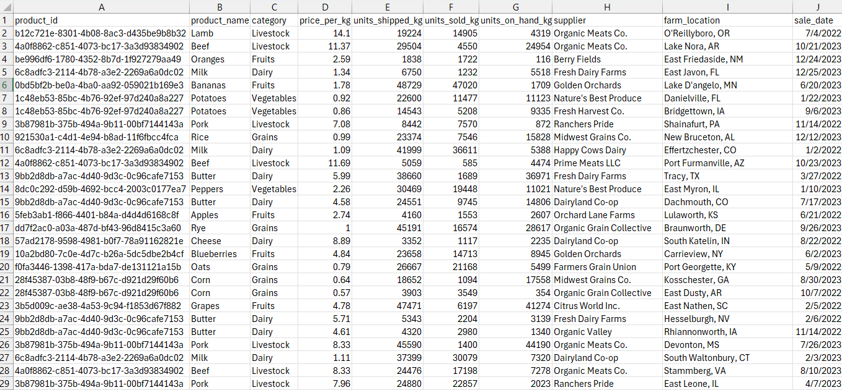
Page 06
DATA BEFORE

Slide 8
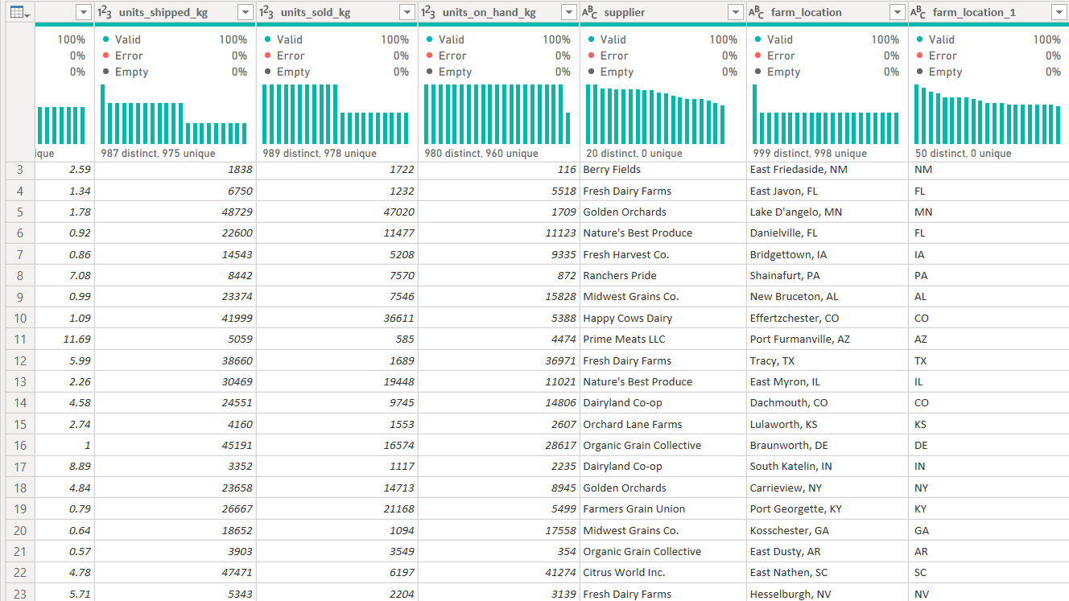
Page 07
SPLITTING FARM LOCATION BY DELIMETER

Slide 9
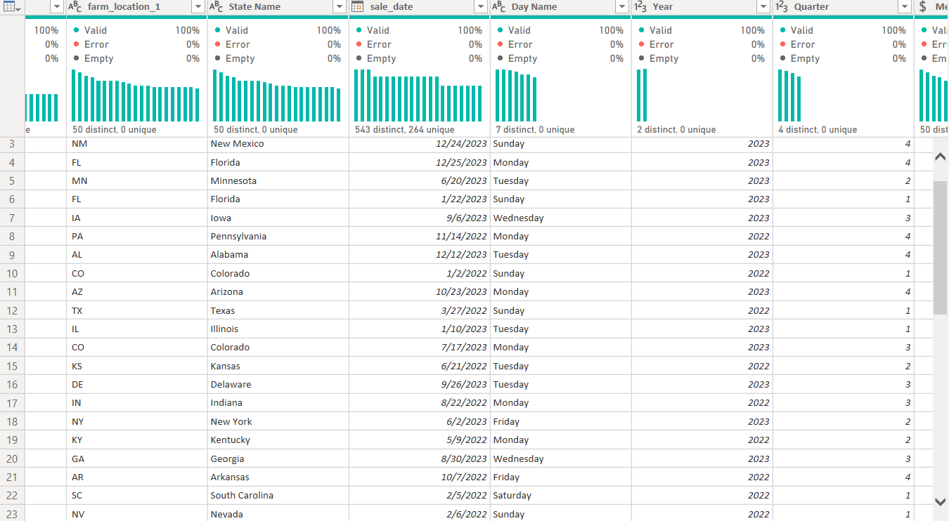
Page 08
EXTRACTING DAY, YEAR AND QUARTAR FROM DATE

Slide 10
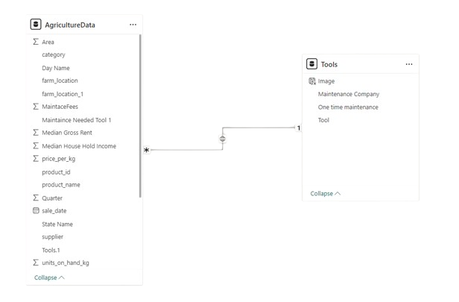
Page 09
ADDING TOOLS TABLE WITH ONE TO MANY RELATION

Slide 11

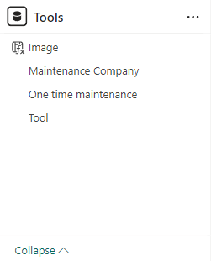
Page 10
NEW COLUMN
TOOL IMAGE
Getting Tool Image From the Internet
Save it in the device
convert image into URL ( More Security about data )
Using Switch() function to assign each Tool with its Image

Slide 12
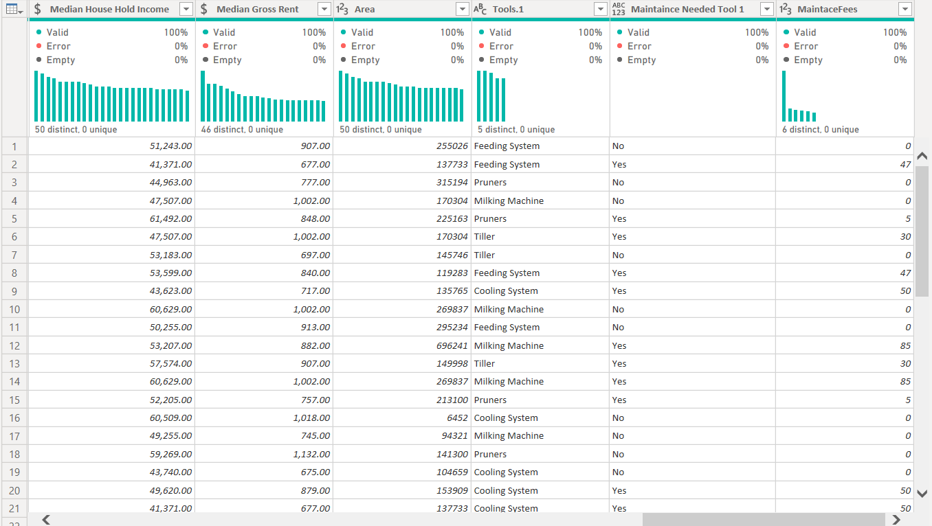
Page 11
ADDING CUSTOM COLUMNS RELATED TO TOOLS

Slide 13

Page 12
Our Measurements
TOTAL REVENUE
Using SUMX()
TOTAL MAINTAIN FEES
Using SUM()
%SOLD
Using SUMX()
AVERAGE FEES
Using AVERAG()
MAX VALUE
Using SUMX()

Slide 14
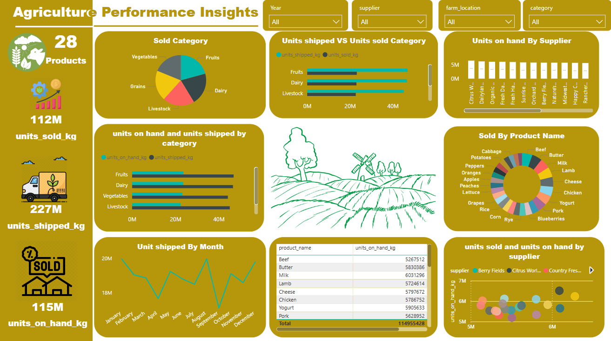
Page 13
Dashboard-Before

Slide 15

Page 14
Dashboard-After

Slide 16

Page 15
Results Based On Revenue Analysis
DAIRY
FRUITS
Product Name : Cheese
Product Total Sold : 6M
Product Revenue : $45.76M
Total Revenue : $98.8M
Product Name : Blueberry
Product Total Sold : 4M
Product Revenue : $22.8M
Total Revenue : $86.71M
VEGETABLES
Product Name : Tomatoes
Product Total Sold : 3M
Product Revenue : $8.38M
Total Revenue : $28.18M

Slide 17
Page 16
Results Based On Revenue Analysis
GRAINS
Product Name : Rice
Product Total Sold : 3M
Product Revenue : $3.45M
Total Revenue : $16.26M
LIVESTOCK
Product Name : Lamb
Product Total Sold : 6M
Product Revenue : $69.96M
Total Revenue : $183.69M

Slide 18
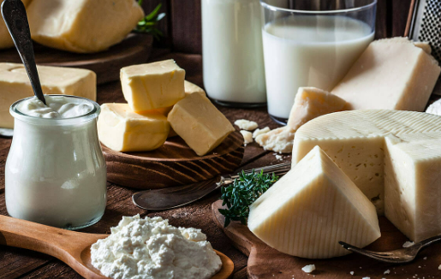
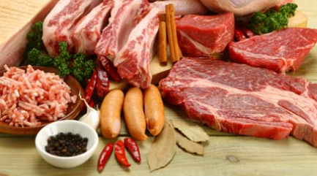
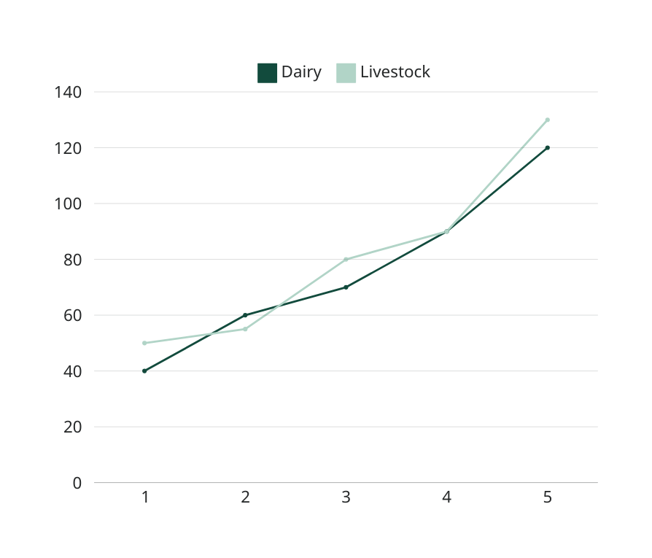
Page 17
High Categories
TOP ONE PRODUCT
Focus on Dairy and Livestock: The Lamb and Cheese products are generating the highest revenues across categories. The company should focus on promoting and scaling these products further.

Slide 19
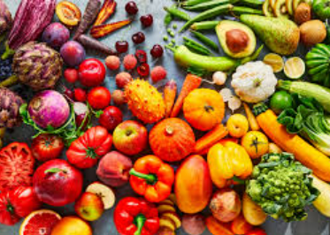
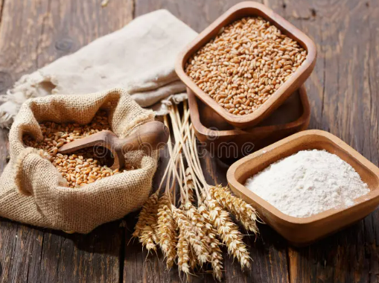
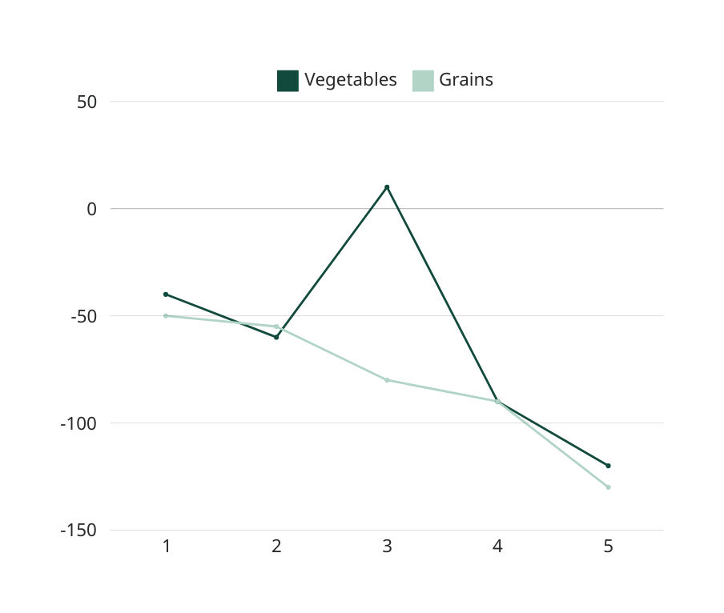
Page 18
Low Categories
TOP ONE PRODUCT
Evaluate Grains and Vegetables: The revenue generated from Rice and Tomatoes is significantly lower. The company should explore opportunities for improvement in these categories by either optimizing costs, increasing sales efforts, or diversifying product offerings.

Slide 20
Page 19
Category Performance Across States
DAIRY
GRAINS
State Name : MaryLand
Total Revenue : $3.26M
State Name : Michigan
Total Revenue : $541K
FRUITS
VEGETABLES
State Name : New Hammpshire
Total Revenue : $2.68M
State Name : Vermont
Total Revenue : $948K
LIVESTOCK
State Name : Tennessee
Total Revenue : $5M

Slide 21
Page 20
Monitor Product Performance Across States
TOP ONE SATES
As shown in the dashboard, analyzing performance across different states can help pinpoint high-potential regions for targeted marketing or product distribution improvements.

Slide 22



Page 21
Thank You

